Slide 1
Tracy’s Grid World
Notes:
Hi, in this video, we’re going to learn about the world Tracy lives in. Let’s get started!

Slide 2
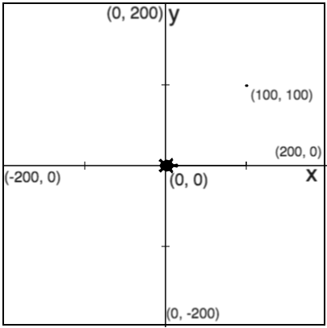
Where Does Tracy Live?
Tracy lives in a grid world.
Tracy’s home!
Tracy always starts at (0, 0).
Notes:
Now we know that Tracy can follow our commands if we give them to her in a specific way, but what do we know about the world Tracy lives in?
Well, Tracy lives in a grid world where an x- and y- axis determines where we move her.
Tracy always starts at her home (click for red box), which is at the very center of our canvas, at coordinate point (0,0).
The x-axis of Tracy’s world goes from (click for red boxes) -200 to +200 and so does (click for red boxes) the y-axis.

Slide 3
Tracy’s Grid World
(-200, 200)
(200, 200)
400 pixels
(-200, -200)
(200, -200)
Notes:
This means that the top left corner (click for box & label) has the coordinate (-200, 200), the bottom left corner (click for box & label) has the coordinate (-200, -200), the top right corner (click for box & label) has the coordinate (200, 200), and the bottom right corner (click for box & label) has the coordinate (200, -200).
So how wide is the total canvas? If our x-axis goes from -200 to +200, that means the width (click for arrow) is 400 pixels long.

Slide 4
Tracy’s Grid World
(-200, 200)
(200, 200)
400 pixels
(-200, -200)
(200, -200)
Notes:
And this is the same for the height (click for arrow) of our canvas. It is important to know that Tracy lives in a 400x400 grid world.

Slide 5
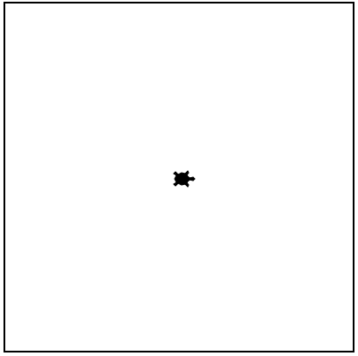
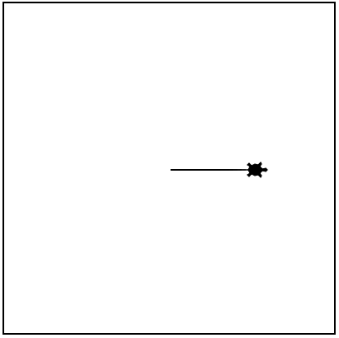
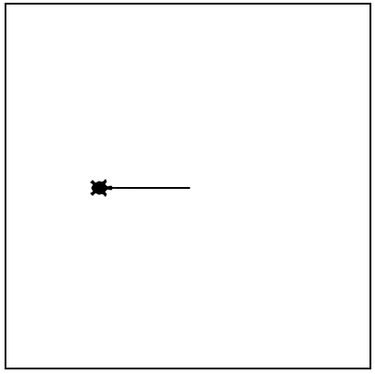
Tracy Command: backward
forward(distance)
backward(distance)
Moves Tracy forward a specified distance
Moves Tracy backward a specified distance
forward(100)
backward(100)
Notes:
We’ve learned how to use two commands already, the forward and circle commands, but Tracy knows how to do more than that!
In the same way that we can move Tracy using the forward command, if you tell her ‘backward’ she will move in reverse the distance that you have entered into the parentheses.

Slide 6
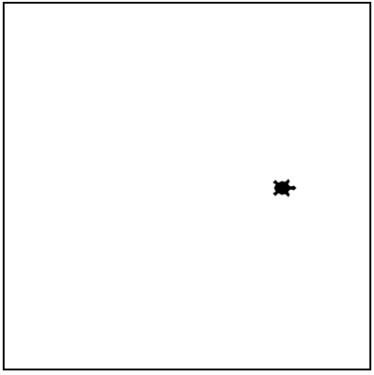
Tracy Command: penup and pendown
penup()
pendown()
Stops Tracy from leaving a trail
Has Tracy start drawing a trail
penup()
forward(100)
pendown()
forward(100)
Note: Tracy always starts with her pen down!
Notes:
We also have some commands to control the trail that Tracy leaves as she moves. If we call the penup() command before telling Tracy to move, she will not leave a trail behind her.
If we then want her to start leaving a trail after we’ve used the penup() command, we can use pendown() to have her start drawing a trail.
An important thing to note (Click for note label) if that Tracy’s default is to draw a line when she moves so you do not need to use the pendown command when you first move her if you want her to leave a trail.
Let’s go ahead and use these commands to write some Tracy programs.

Slide 7
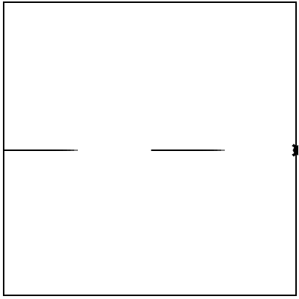
Example #1: 2 Dashes
Write a program that has Tracy draw 2 dashes across the x-axis of the canvas.
Notes:
In this program, we want to write a code that will tell Tracy to draw 2 dashes across the x-axis of our canvas.

Slide 8
Commands Learned this Lesson
Command | What does it do?
backward(distance) | Moves Tracy backward a specified distance
penup() | Stops Tracy from leaving a trail
pendown() | Has Tracy start drawing a trail
Notes:
In this lesson, we learned about the grid world Tracy lives in and how to use the backward, penup, and pendown commands. Now it’s your turn to use these Tracy commands to solve some coding challenges!

